Slide 1
无人驾驶高精地图和V2X HD MAP & V2X
BUSINESS
2019
JULYED
北京七月在线科技有限公司
盛老师 BAT无人驾驶高级算法工程师
https://www.julyedu.com/

Slide 2

CONTENTS
01
HD MAP OVERVIEW
02
OPENDRIVE PROTOCAL
03
CLOUD POINT MAPPING
04
V2X
无人驾驶实战与应用
julyedu.com

Slide 3
HD MAP OVERVIEW
01

Slide 4




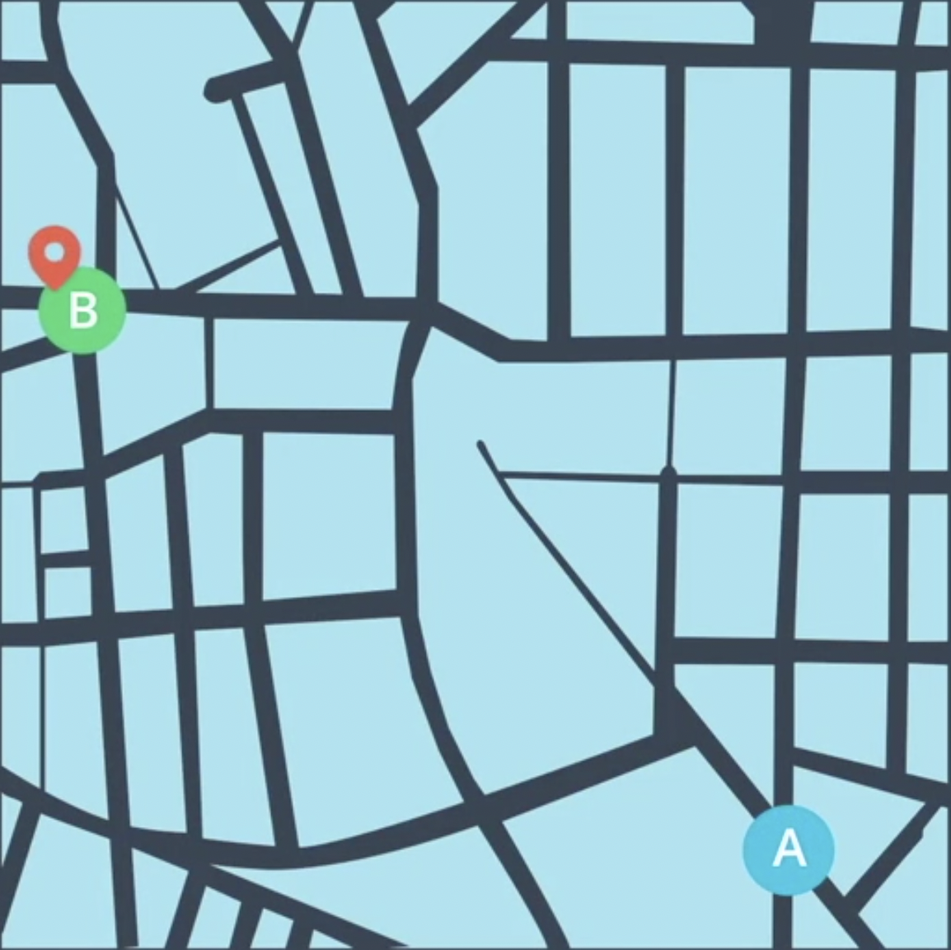
AUTOMOUS SOFTWARE STACK
Perception
Planning
Control
HD Map
Localization

Slide 5
AUTOMOUS SOFTWARE STACK
Perception
Planning
Control
HD Map
Localization

Slide 6
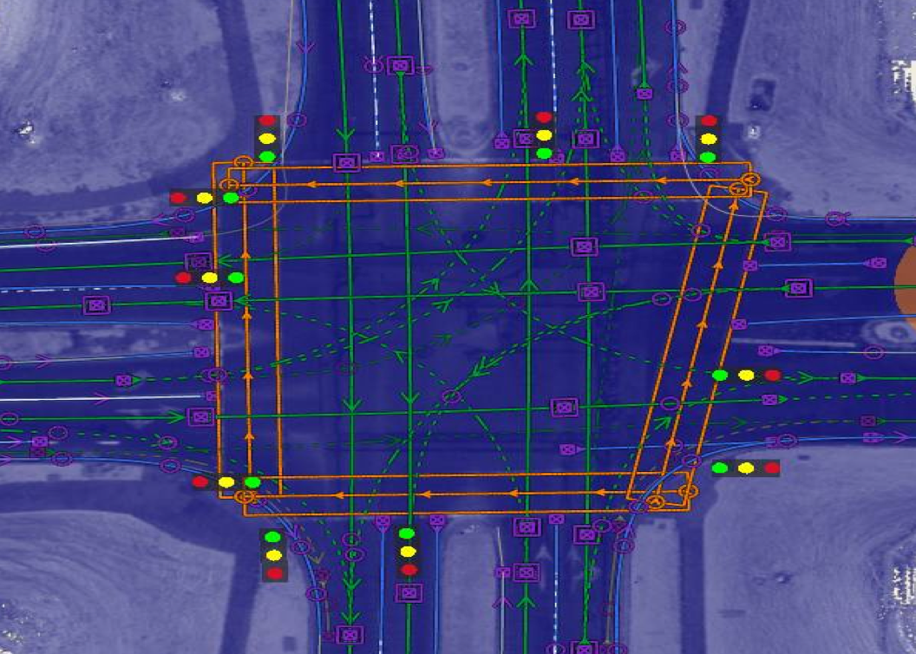
HD MAP
Visualization
Static Objects
HD Map Info

Slide 7
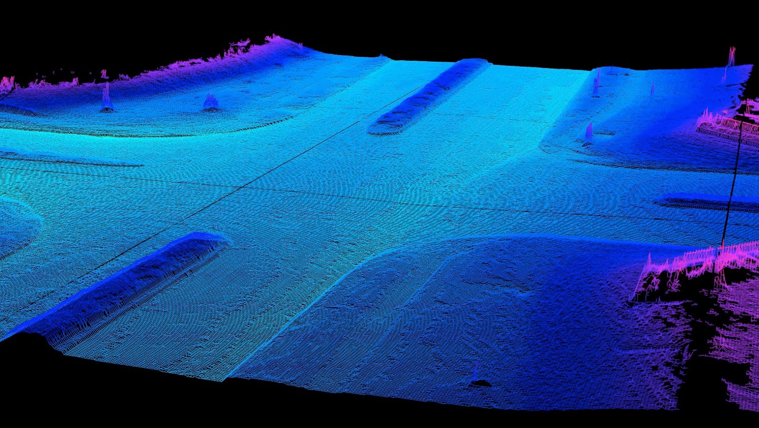
HD MAP
Visualization
Static Objects
HD Map Info
Lidar Cloud Point Map

Slide 8
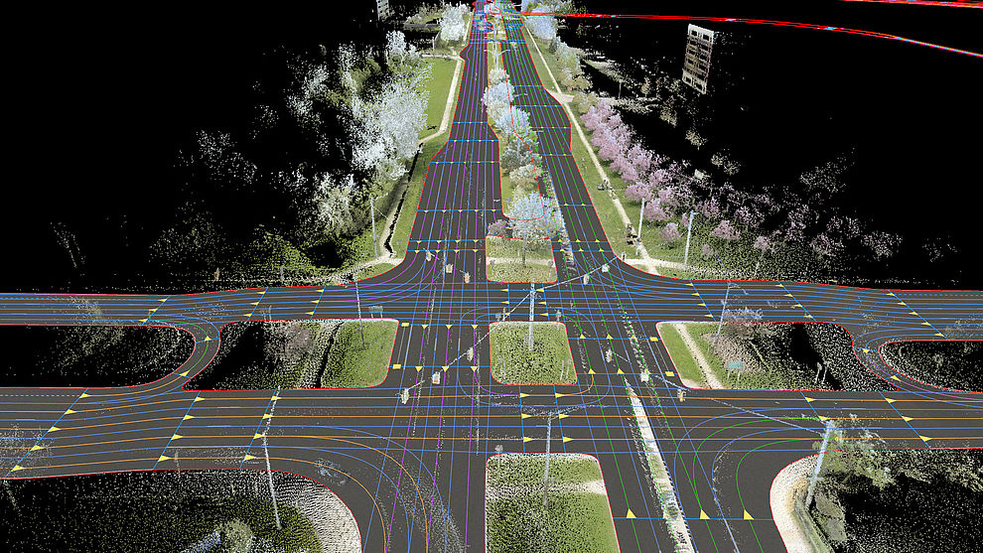
HD MAP
Visualization
Static Objects
HD Map Info
Lidar Cloud Point Map
Merging

Slide 9
HD MAP vs NAVIGATION MAP
 | High Definition Map High Dimension Map | Navigation Map
Precision | cm | m
Information | 3D lane info More detail signals | Basic info
Usage | Autonomous vehicle or robotics | Human

Slide 10


LOCALIZATION
Self-localization
Camera & Point cloud
Pre-processing
Coordinate transformation
Data fusion
High precision

Slide 11

PERCEPTION
High range visualization

Slide 12
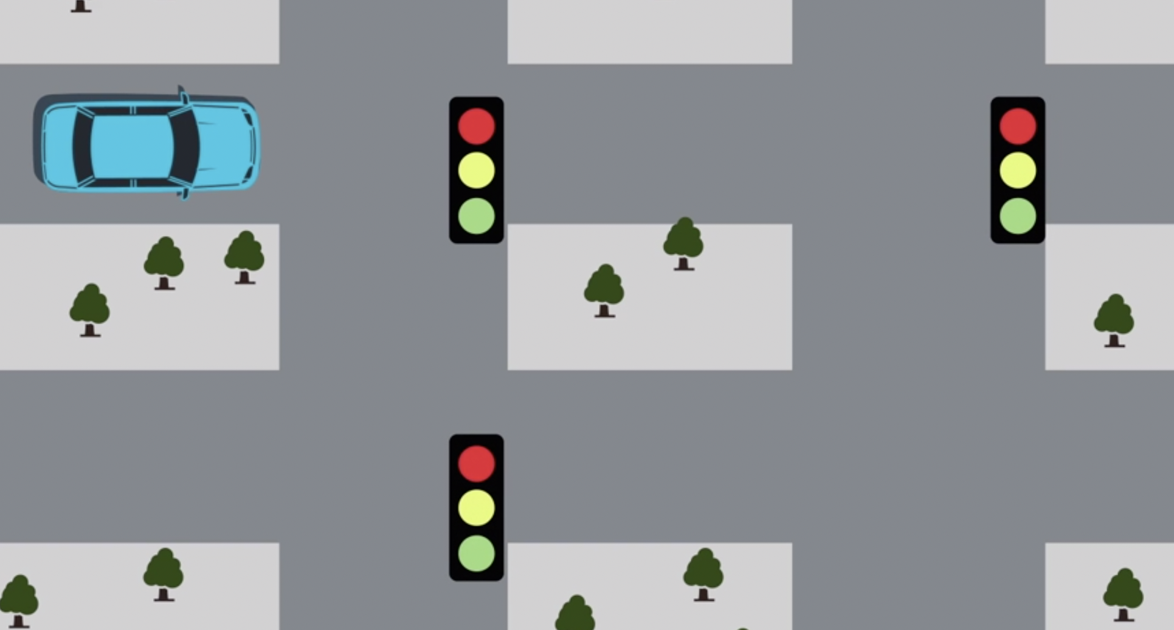
PERCEPTION
High range visualization
ROI
Saving computation

Slide 13
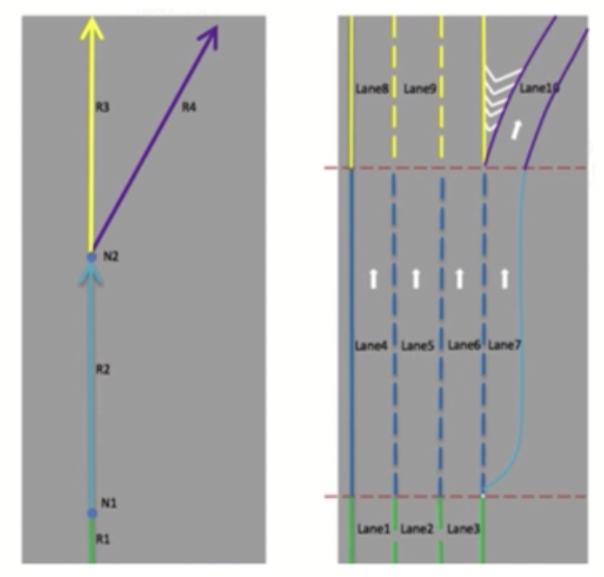
PLANNING
Lane center
Reference line
Boundary
Road network
Merging zone
Junction
Traffic information
Stop sign
Speed limit

Slide 14
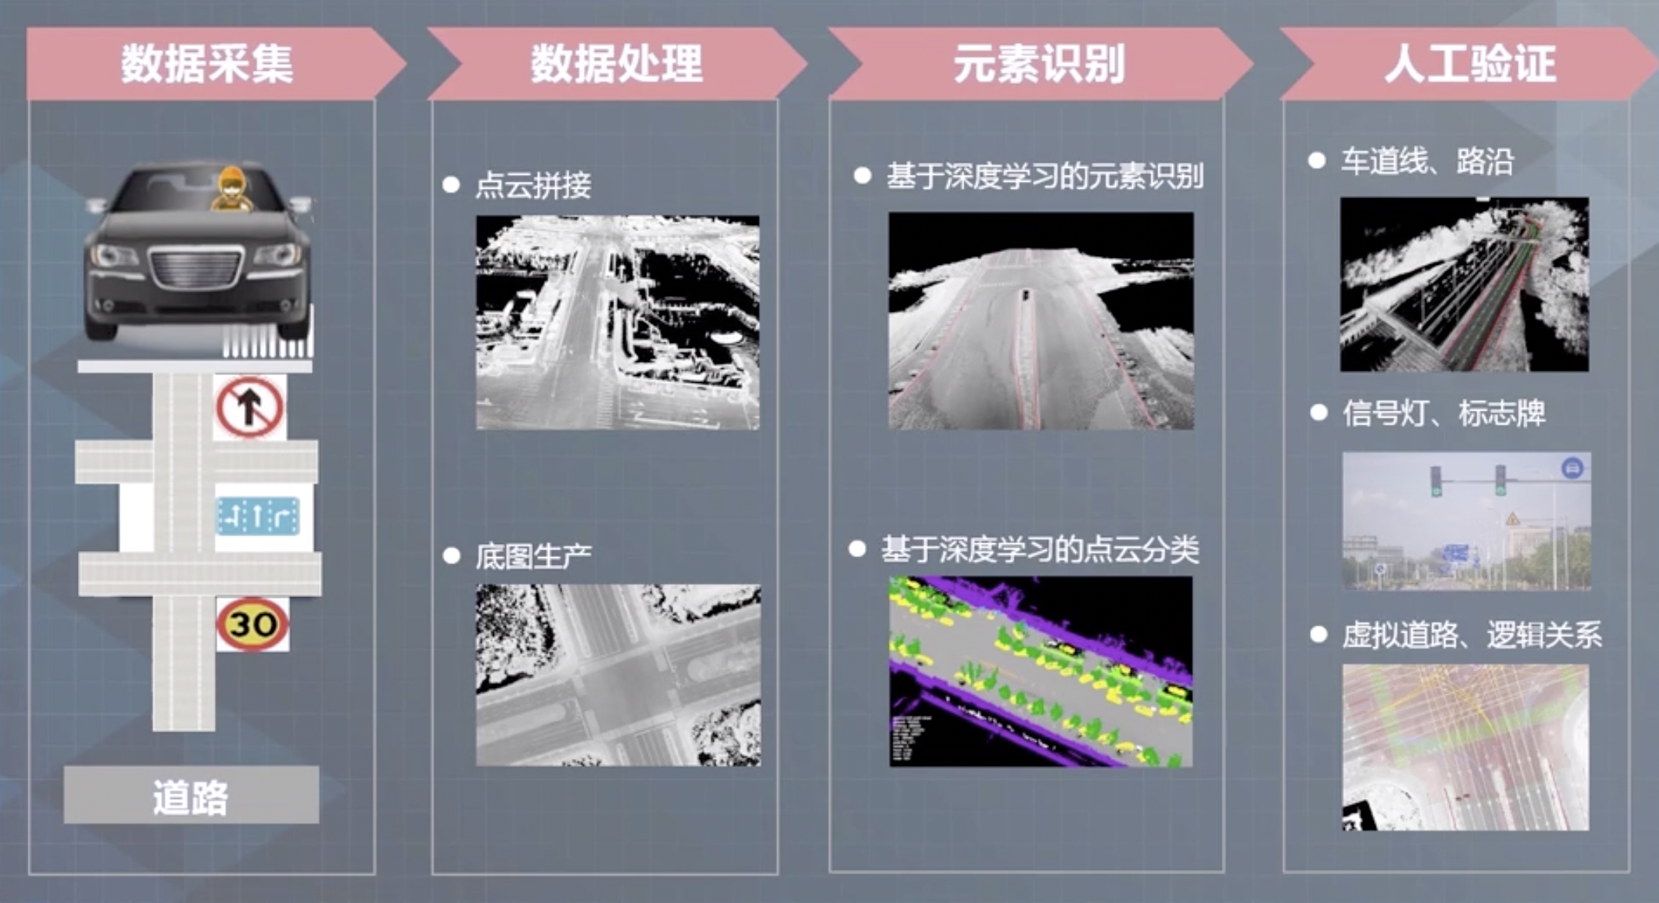
APOLLO HDMAP
Data Collecting
Data Processing
Object Classification
Human Verification

Slide 15
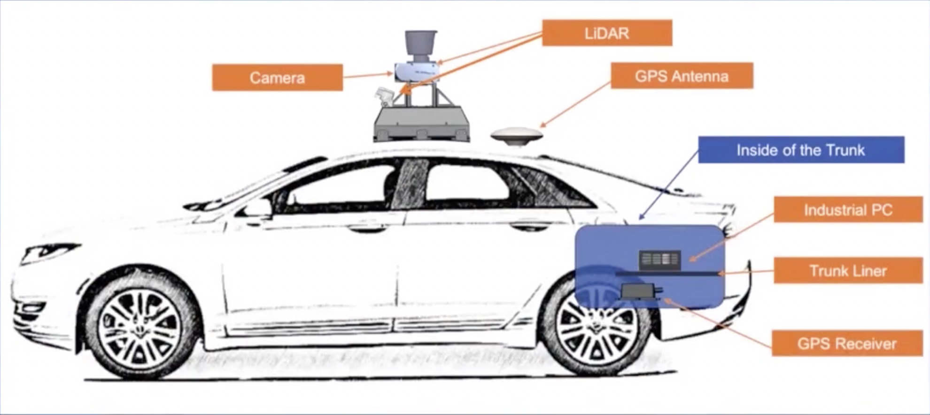

APOLLO HDMAP

Slide 16
SLAM
Sensor Data
Visual Odometry
Optimization
Mapping
Loop Closing

Slide 17
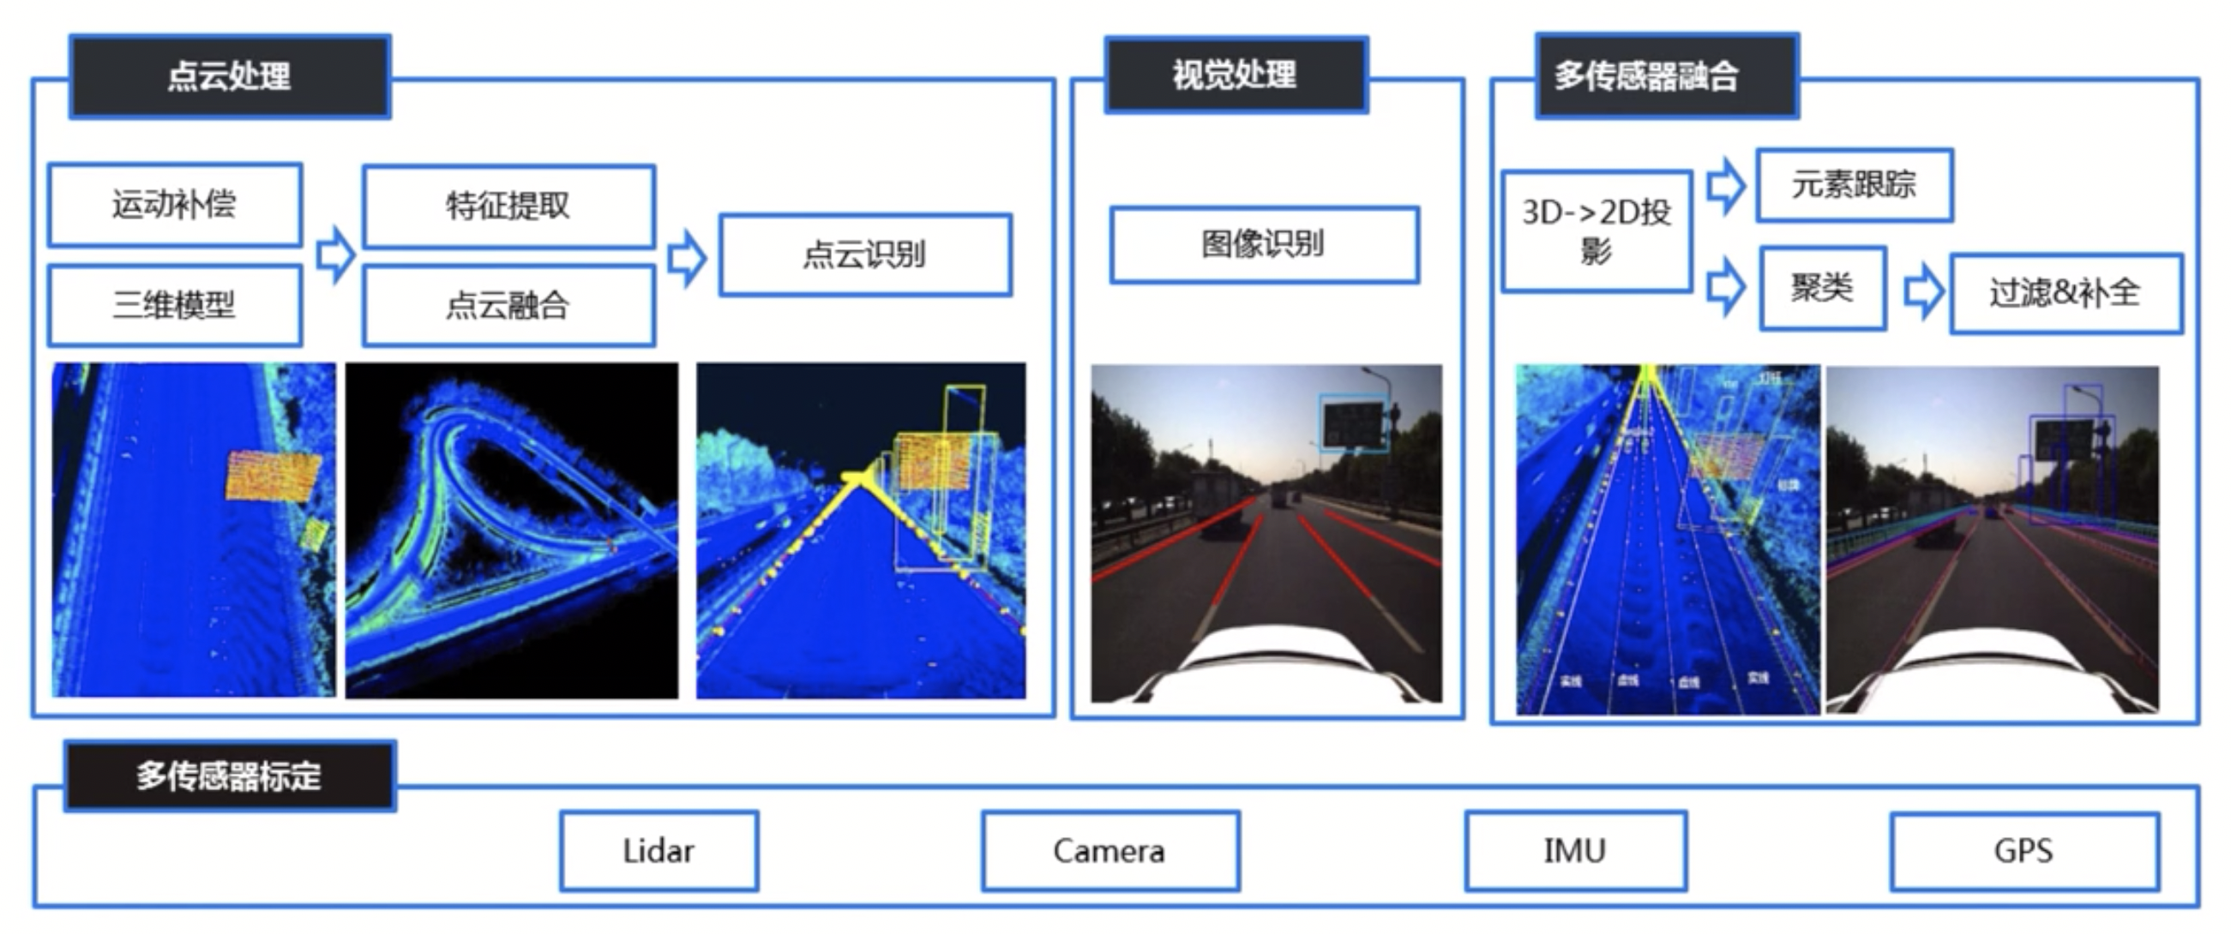
HDMAP AI

Slide 18
OPENDRIVE PROTOCAL
02

Slide 19
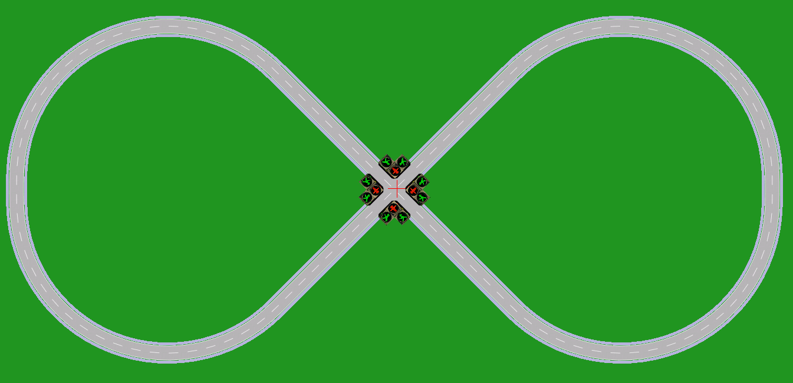
OPENDRIVE
OpenDRIVE® is an open file format for the logical description of road networks
Contains real road networks
Free and vendor-independent
A broad international user base
Since 2006 and many user cases

Slide 20
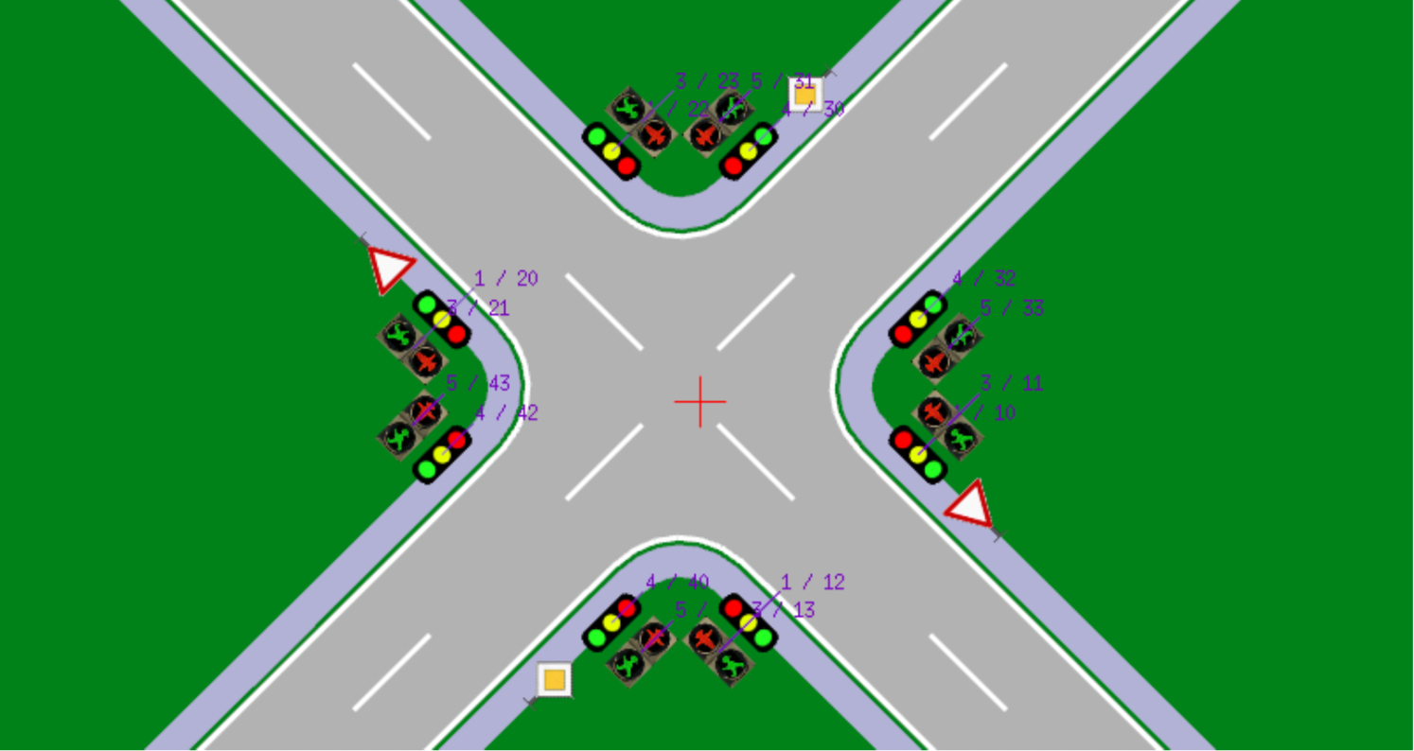
OPENDRIVE
odrViewer 64.1.9.1
Linux tool
Don't open source

Slide 21
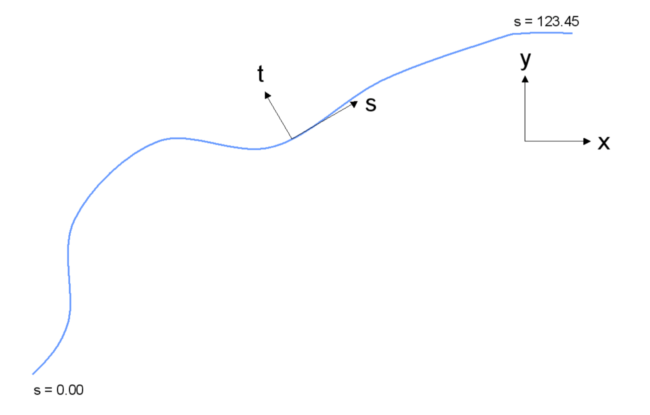
COORDINATE
Track co-ordinates (Frenet co-ordinate)
Inertial co-ordinates

Slide 22
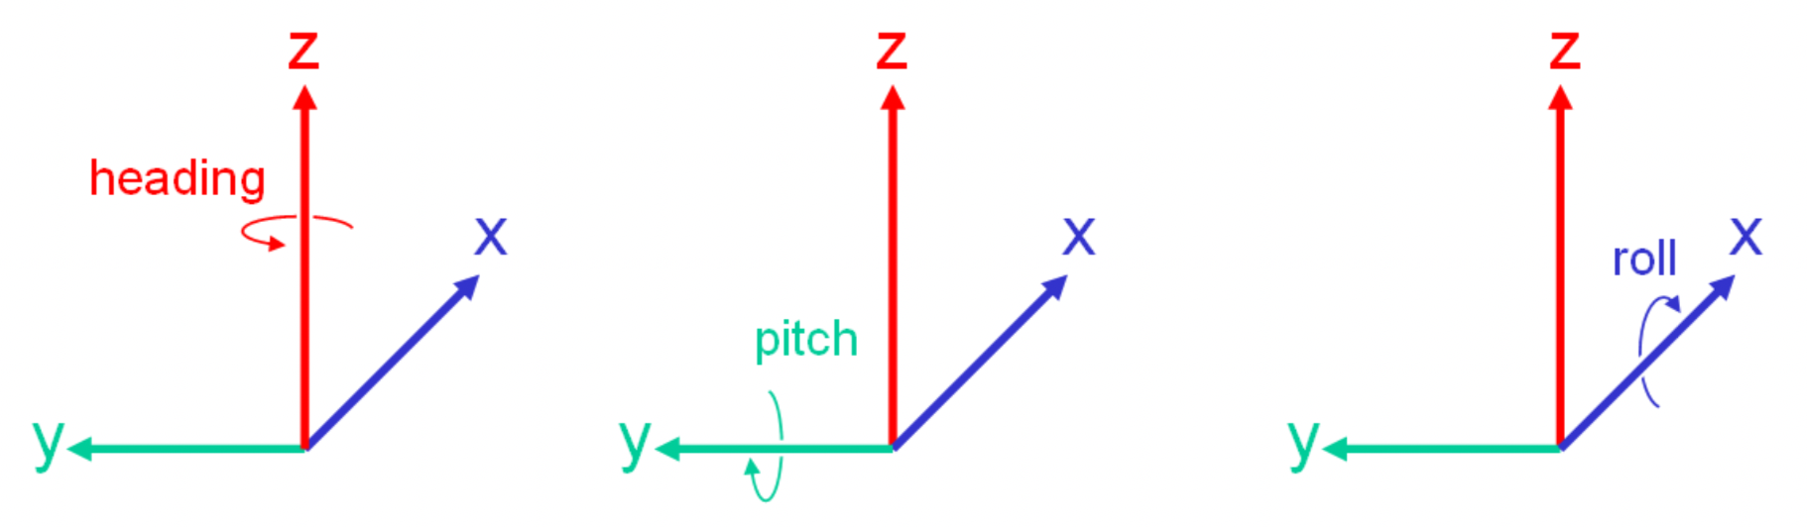
COORDINATE
Heading (Yaw)：偏航
Pitch：俯仰
Roll：滚转
X : forward
Y : left
Z : up
Inertial system

Slide 23

COORDINATE
Track system
S : position along reference line
T : lateral position
H : up

Slide 24

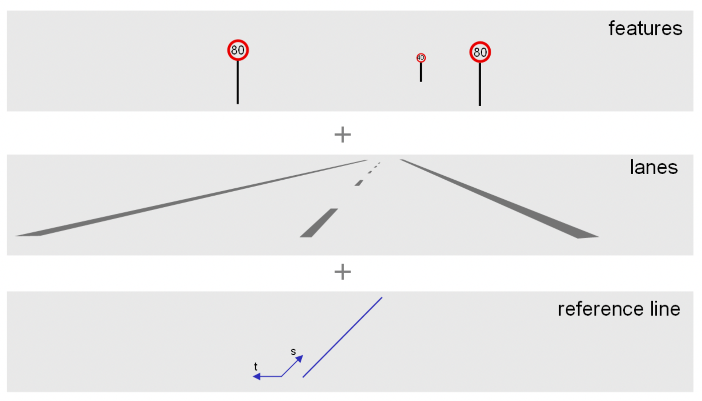
ROAD

Slide 25
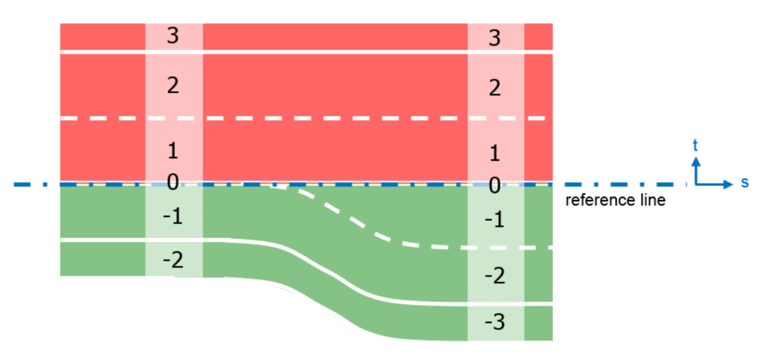
ROAD
Lanes are identified by numbers
Unique
In sequence
Starting from 0 on the reference line
Ascending to the left
Descending to the right

Slide 26
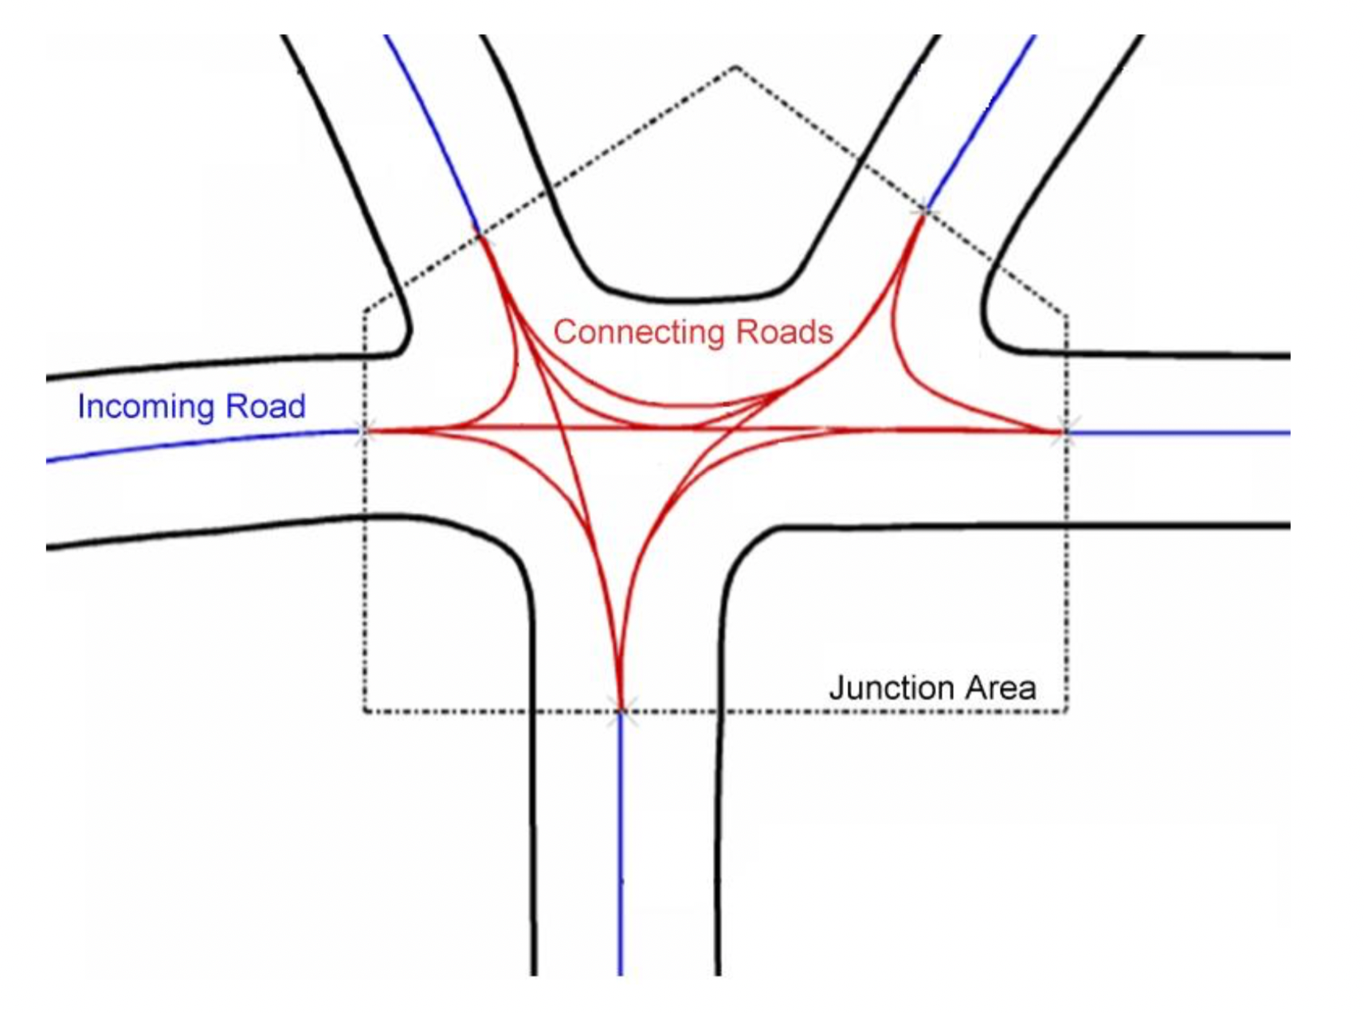
JUNCTION
Junctions link in-coming roads via paths (connecting roads) to out-going roads
Junction group
Junction incoming
Junction off-line

Slide 27
CLOUD POINT MAPPING
03

Slide 28
SLAM
Sensor Data
Visual Odometry
Optimization
Mapping
Loop Closing

Slide 29
Lidar & Image
Sensing fusion : Camera-Lidar-Radar^{[1]}
Depth information : XYZ
Image information : RGB
Joint object classification & detection
iDAR : RGB image from Camera + 3D cloud point from Lidar (AEye, MobilEye)^{[2]}
SLAM : Sensor pose estimation + Particle filter
Mapping : Reconstruct global maps^{[3]}
[1]:林鸿生. 成像激光雷达与摄像机的图像融合研究[D]. 国防科学技术大学, 2007.
[2]:https://www.aeye.ai/idar/
[3]:Zhang F , Clarke D , Knoll A . Vehicle Detection Based on Li DAR and Camera Fusion[C]. 2014 IEEE 17th International Conference on Intelligent Transportation Systems (ITSC).

Slide 30
V2X
04

Slide 31
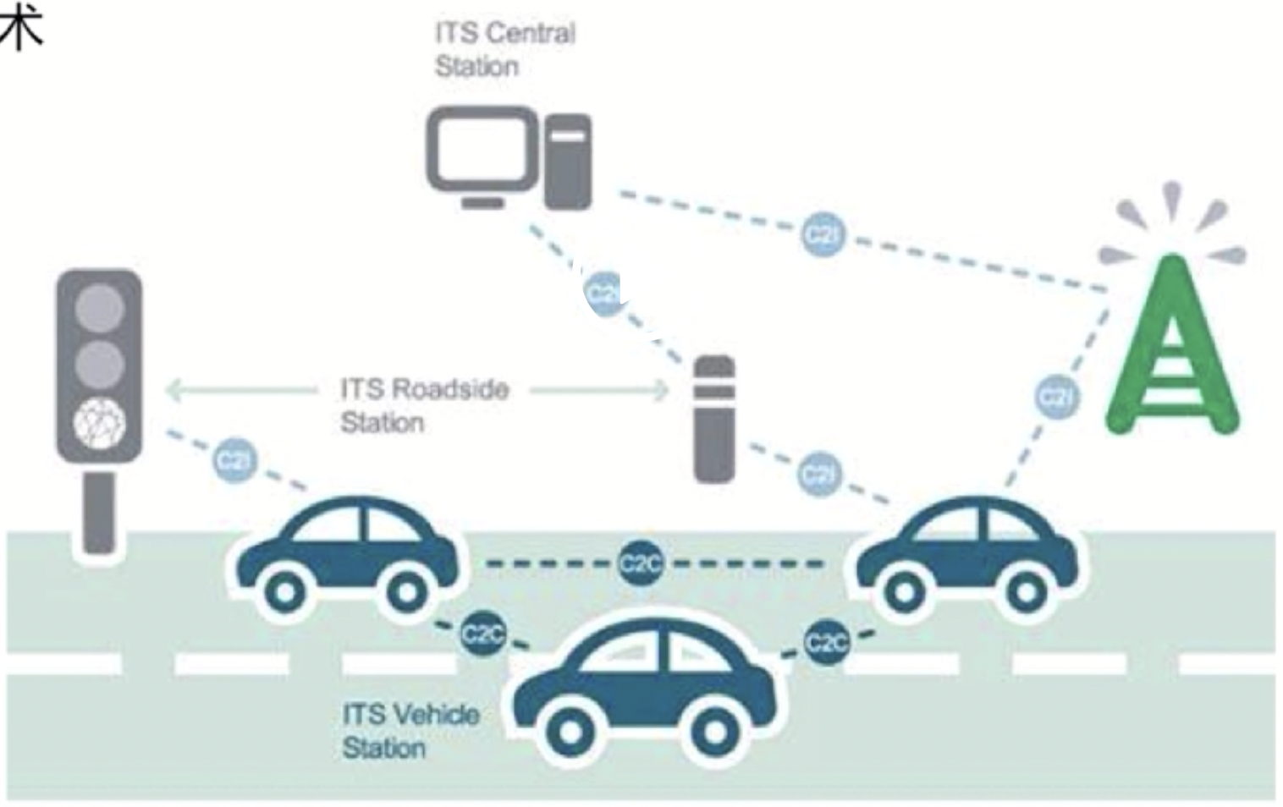
V2X
Sensor
HD Map
Static Perception
V2X
Low latency
High robust
Dynamic network

Slide 32
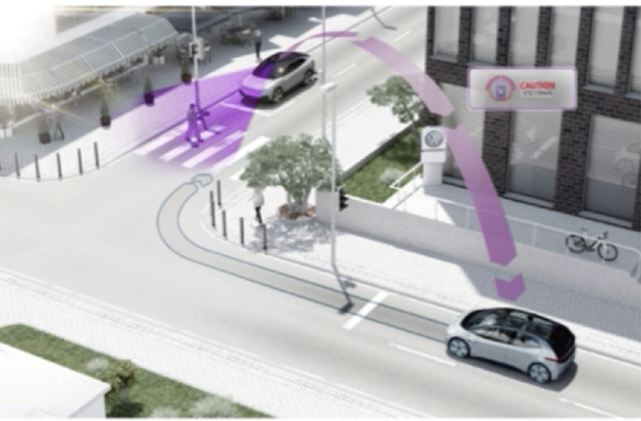
V2X
Sensor
HD Map
Static Perception
V2X
Low latency
High robust
Dynamic network
Beyond visual range

Slide 33
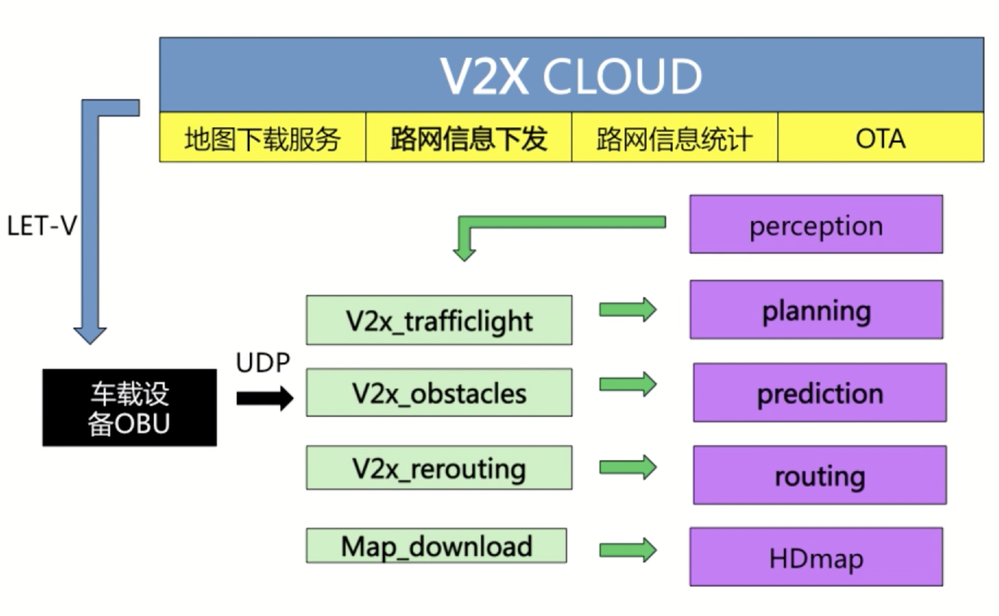
5G + V2X
C-V2X (LTE-V)
China
Share station
Direct mode
大唐、华为
DSRC (Dedicated Short Range Communication)
US, Japen
WIFI
5.8GHz
Sony、AT&T
Map Server
Road Info
Traffic Predict
OTA
OBU

Slide 34
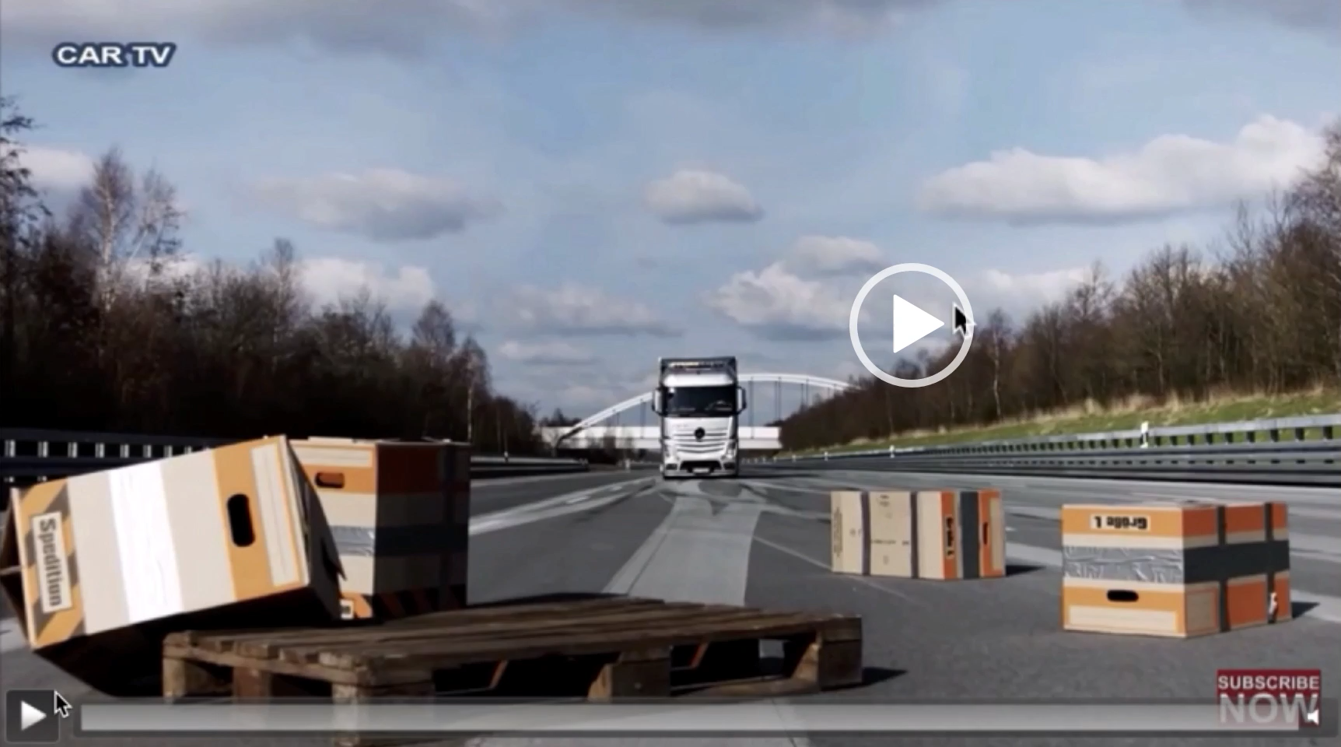
Demo

Slide 35
SUMMARY
HDMAP Overview
OpenDrive Format
SLAM :
Joint Mapping
V2X

Slide 36
HOMEWORK
1. Reading:
OpenDrvie Spec : Format Specification, Rev. 1.4
Lanelets: Efficient map representation for autonomous driving
Automatic laser calibration, mapping, and localization for autonomous vehicles, 2011, Stanford Dissertation
2. Coding:
Parse another element (whatever you like) with OpenDrive format
Complement join mapping project
OpenCV practice
3. Thinking:
HD map format : Storage efficiency
HD map C API : Time cost

Slide 37
微信扫一扫关注我们
盛老师 BAT无人驾驶高级算法工程师
https://www.julyedu.com/

